Slide 1

50.039 Theory and Practice of Deep Learning W3-S3 Introduction to Deep Learning using the PyTorch framework
Matthieu De Mari

Slide 2
Introduction (Week 3)
What is the PyTorch library and its benefits?
What is a PyTorch tensor object and its typical attributes?
How to implement some typical tensor operations?
What is broadcasting on tensors?
What are tensor locations in terms of computation?
How to transform our original NumPy shallow Neural Network class so it uses PyTorch now instead?
How to implement a forward, loss and accuracy metric in PyTorch?
What are some measurable performance benefits of using PyTorch over NumPy and GPUs over CPUs?

Slide 3
Introduction (Week 3)
What is the autograd/backprop module in PyTorch, and how does it use a computational graph to compute all derivatives?
How to use the autograd to implement derivatives and a vanilla gradient descent?
How to implement backprop in PyTorch for our shallow Neural Network class?
How to use PyTorch to implement advanced optimizers?
How to use PyTorch to implement advanced initializers?
How to use PyTorch to implement regularization?
How to finally revise our trainer function to obtain a minimal, yet complete Neural Network in PyTorch?

Slide 4
Introduction (Week 3)
What are the Dataset and Dataloader objects in PyTorch?
How to implement a custom Dataloader and Dataset object in PyTorch?
How to move from binary classification to multi-class classification?
How to adjust output probabilities using the softmax function?
How to change the cross-entropy loss so it works in multi-class classification?
How to implement building blocks in PyTorch?
How to implement and train our first Deep Neural Network?
What are additional good practices in PyTorch?

Slide 5
To summarize (last two sessions)
We now have a full Neural Network class, in PyTorch, with:
2 linear layers, sigmoid activation functions,
Xavier uniform initialization on trainable parameters,
Forward pass method,
Autograd backpropagation and trainer method,
Adam optimizer,
Dataloader allowing for stochastic mini-batches,
Cross entropy loss and accuracies,
L1 regularization.
And it runs/trains at the speed of light (almost…) on GPU!

Slide 6
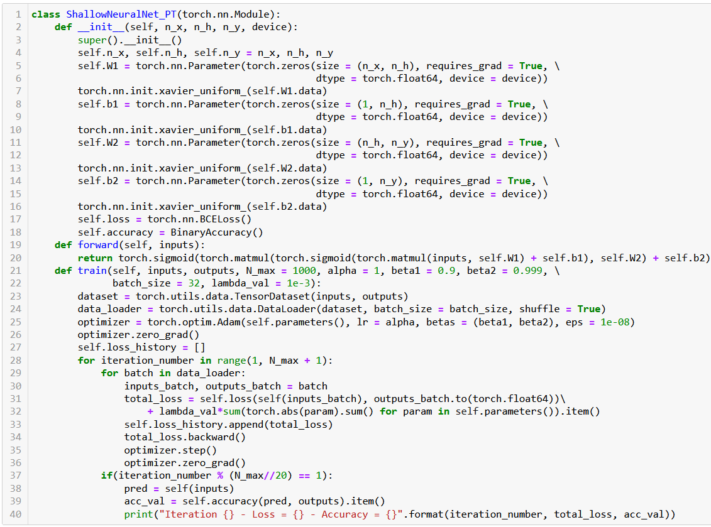

Slide 7
Built-in datasets
Pytorch has a few built-in datasets, ready to be downloaded and used on models: typically, the most common ones that have been used in research to demonstrate concepts, such as MNIST or CIFAR-10.
For more details on the available built-in datasets in Pytorch, have a look at the following page: https://pytorch.org/vision/stable/datasets.html.

Slide 8
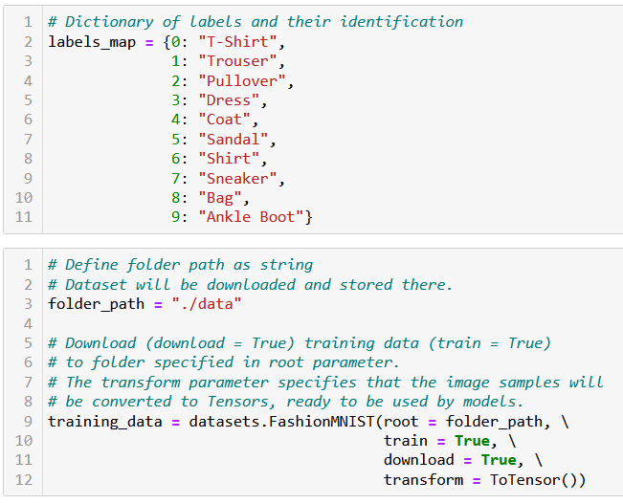
Built-in datasets
Let us demonstrate using the FashionMNIST dataset.
This dataset consists of 28 by 28 greyscale images.
It is typically used to design image classification models (i.e. models that receive images as inputs) and attempt to predict what is in the image in question.
The 10 output classes (bag, shirt, etc.) are indexed with 0-9 values, corresponding to the 10 types of fashion objects found in the dataset.

Slide 9
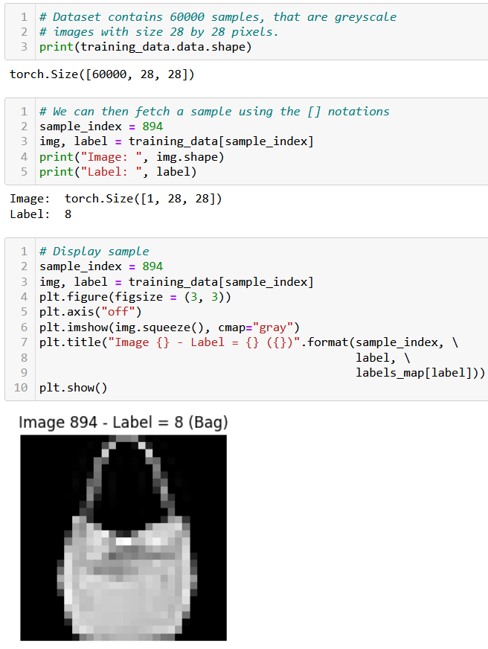
Built-in datasets
Let us demonstrate using the FashionMNIST dataset.
This dataset consists of 28 by 28 greyscale images.
It is typically used to design image classification models (i.e. models that receive images as inputs) and attempt to predict what is in the image in question.
The 10 output classes (bag, shirt, etc.) are indexed with 0-9 values, corresponding to the 10 types of fashion objects found in the dataset.

Slide 10
Writing a custom Dataset object
Most of the time, when demonstrating concepts, we will rely on a "simple" built-in dataset, available in the PyTorch library. In practice, however, you will often play with a custom dataset, fitting your project needs.
Most datasets will be provided by your company, or can be found on dataset search engines, such as Kaggle, Google Dataset Search, etc.
Today, we will play with a simplified version of the Ames Housing Dataset, which can be found online, here: https://www.kaggle.com/datasets/prevek18/ames-housing-dataset?resource=download

Slide 11

A look at our dataset Excel file

Slide 12
Writing a custom Dataset object
The Ames dataset includes a variety of features for approximately 2,800 houses in Ames, Iowa.
Features include the size of the house (in square feet), the number of bedrooms and bathrooms, and many more. It also includes the sale price for each house.
The Ames Housing Dataset is a popular choice for machine learning projects, and it has been used to build AI models for predicting house prices, based on various house features.
It consists of an Excel file (AmesHousing.xlsx) stored in the ./ames/ folder. The original dataset can be found in the AmesHousing.csv file, but we have simplified it by removing some of its features.

Slide 13
Writing a custom Dataset object
The features we are interested in are:
Lot Area: The area of the lot in square feet.
Overall Qual: A rating of the overall material and finish of the house (1-10).
Overall Cond: A rating of the overall condition of the house (1-10).
Year Built: The year the house was built.
Year Remod/Add: The year the house was remodeled or had an addition added.
Total Bsmt SF: The total surface of the basement, in square feet.
1st Flr SF: The first floor surface, in square feet.
2nd Flr SF: The second floor surface, in square feet.
Gr Liv Area: The above grade (ground) living area, in square feet.
Full Bath: The number of full bathrooms.
Half Bath: The number of half bathrooms.
Bedroom AbvGr: The number of bedrooms.
Kitchen AbvGr: The number of kitchens.
TotRms AbvGrd: The total number of rooms (does not include bathrooms).
Garage Area: The size of the garage, in square feet.
Yr Sold: The year the property was sold.
These 16 features will be used as inputs, and the output will consist of just 1 feature, in the final column of the Excel file, which is:
SalePrice: The sale price, in dollars.

Slide 14
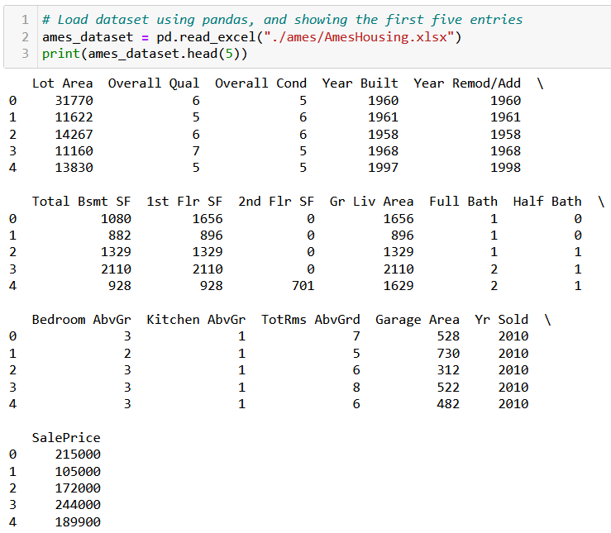
Writing a custom Dataset object
Let us start by loading the Excel file into a pandas DataFrame first.
(Note: Not familiar with the pandas library? Find 10 minutes to learn it, it will definitely serve you in the long run!
https://pandas.pydata.org/docs/user_guide/10min.html)

Slide 15
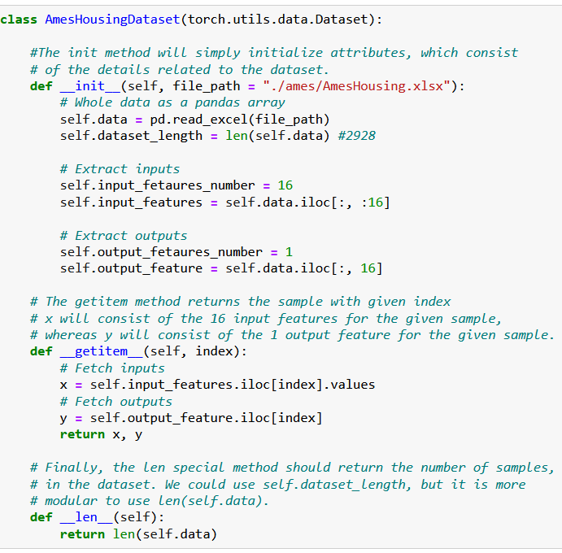
Writing a custom Dataset object
To write a custom dataset class in PyTorch, we need to:
Create a class that subclasses torch.utils.data.Dataset.
Define a an __init__ that takes in the required arguments, and stores them as member variables.
Define a __getitem__ that takes index as input, and returns the data and label at that index as an array. This will allow to use the square bracket notation on our dataset object.
Define a method __len__ that returns the number of samples in the dataset.

Slide 16
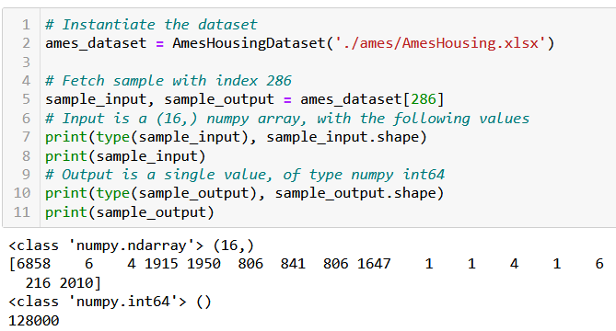
Writing a custom Dataset object
The __getitem__() and __len__() special methods will allow for indexing the dataset object.
Later on, we could ask for the sample #286 using the square bracket notation, as shown on side.
Similarly, the two special methods are all we need to make a for loop that uses the dataset object as the generator to be looped over!
More on the for loop later!

Slide 17
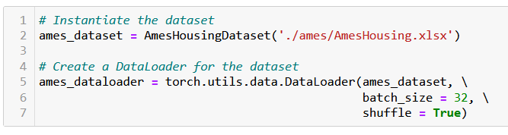
Writing a custom Dataloader
Before we can feed this dataset object to Neural Networks, we need to supplement it with a Dataloader.
The Dataloader will shuffle the samples randomly and produce mini-batches of a given size.
This Dataloader typically allows for stochastic mini-batches, as discussed in Week 2.
The Dataloader will also transform arrays into tensors.

Slide 18
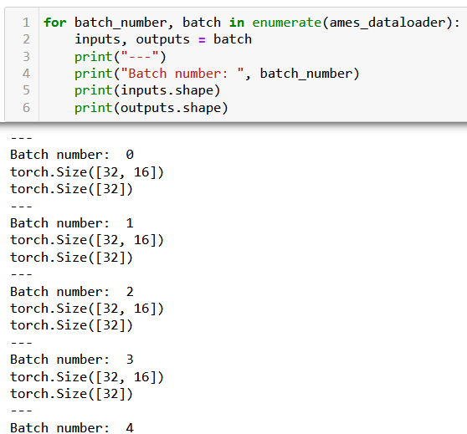

Writing a custom Dataloader
We can then use this custom Dataloader object as the generator in a for loop, to generate mini-batches of samples.
Notice how this Dataloader generates 92 (i.e. 2928/32, rounded up) batches of 32 samples.
With the exception of the last batch (with index 91), that only contains 16 samples (that is 2928 % 32).

Slide 19
Writing a custom Dataloader
We can then use this custom Dataloader object as the generator in a for loop, to generate mini-batches of samples.
Good practice: the custom Dataset and custom Dataloader definition should be repeated to generate training, testing and validation sets dataloaders.
These Dataloaders will then be given to our trainer function.

Slide 20
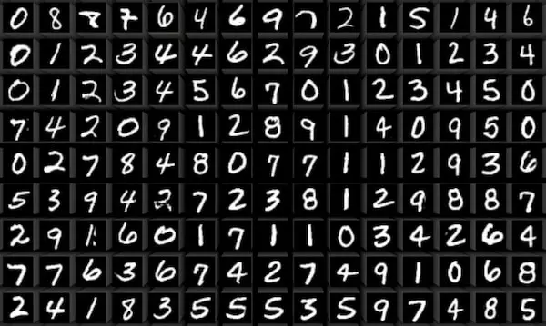
Introducing the MNIST dataset
MNIST is a widely-used dataset for the benchmarking of machine learning and computer vision algorithms.
It consists of
a training set of 60,000 examples,
and a testing set of 10,000 examples.
All samples consist of 28x28 pixel grayscale images of handwritten digits (0 to 9).
MNIST is often used as a "Hello, World!" example, due to its simplicity, which allows for efficient implementations of ML/DL algorithms.

Slide 21
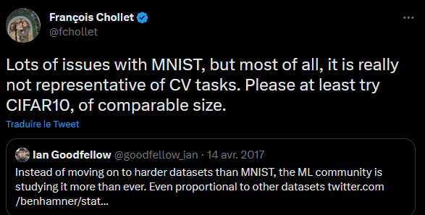
Introducing the MNIST dataset
MNIST is a widely-used dataset for the benchmarking of machine learning and computer vision algorithms.
It consists of
a training set of 60,000 examples,
and a testing set of 10,000 examples.
All samples consist of 28x28 pixel grayscale images of handwritten digits (0 to 9).
Careful however: the MNIST dataset is often accused of having been overused (which is true) and of being too simple.
For now, however, this will do.

Slide 22
Introducing the MNIST dataset
Nevertheless, it is a good dataset to use for testing and comparing the performance of different models, as well as for getting familiar with the basics of machine learning and deep learning algorithms.
The images serve as inputs, and the task is therefore to predict which of the ten digits appears in the image.
This is therefore a classification task, like before, except that it consists of 10 different classes (corresponding to the 0-9 digits) instead of just two like in binary classification.

Slide 23
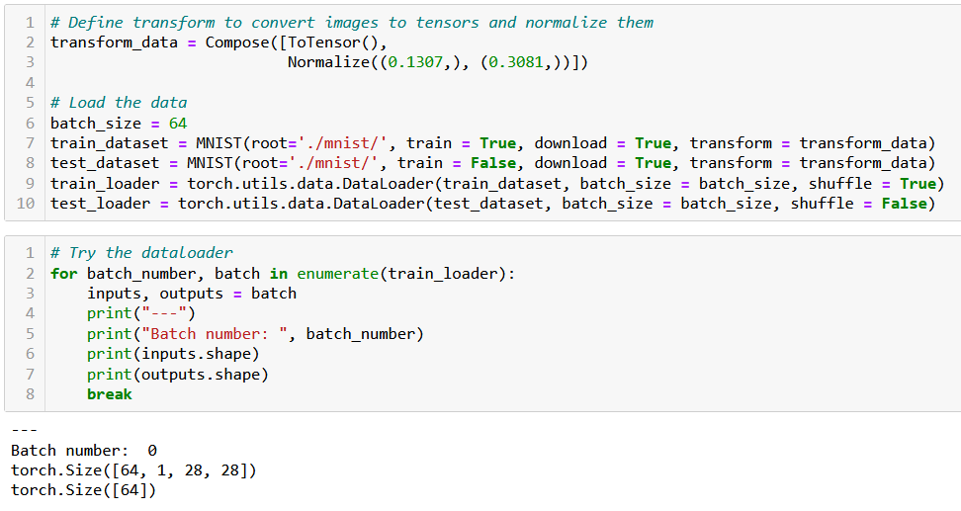
Writing the MNIST Dataset and Dataloader

Slide 24
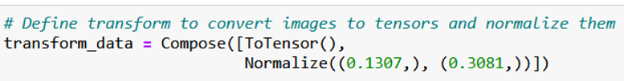
Introducing the MNIST dataset
Good practice: always normalize your input data!
In general, do the following:
Scale the data (pixel values) to the [0,1] range.
Normalize to have zero mean and unit standard deviation.
In MNIST, we will then subtract a mean of 0.1307 and divide by a standard deviation of 0.3081.
These values are the original mean and standard deviation of the dataset before normalization!

Slide 25
Writing the MNIST Dataset and Dataloader

Slide 26
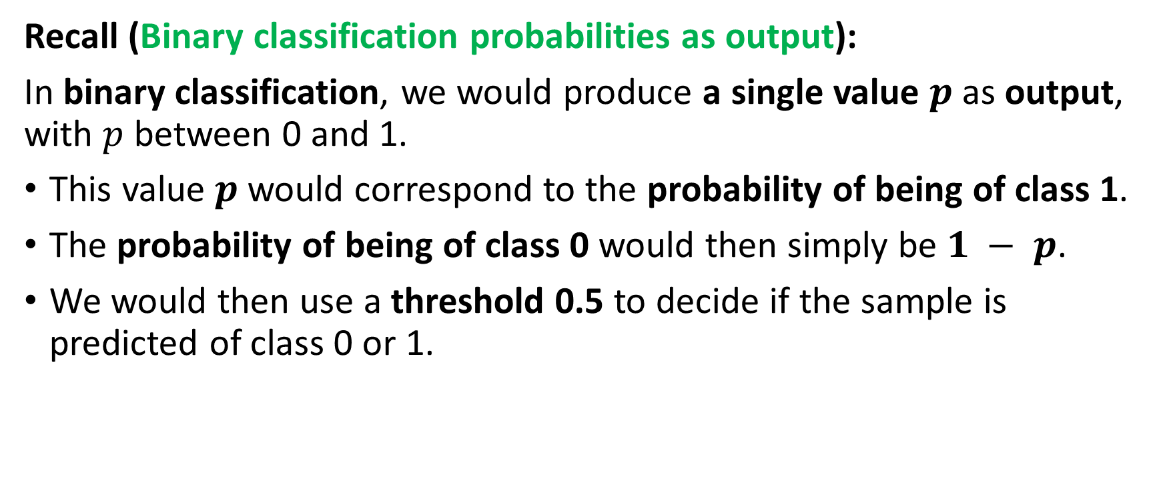
From binary to multi-class classification
Recall (Binary classification probabilities as output):
In binary classification, we would produce a single value $p$ as output, with $p$ between 0 and 1.
This value $p$ would correspond to the probability of being of class 1.
The probability of being of class 0 would then simply be $1 − p$.
We would then use a threshold 0.5 to decide if the sample is predicted of class 0 or 1.

Slide 27
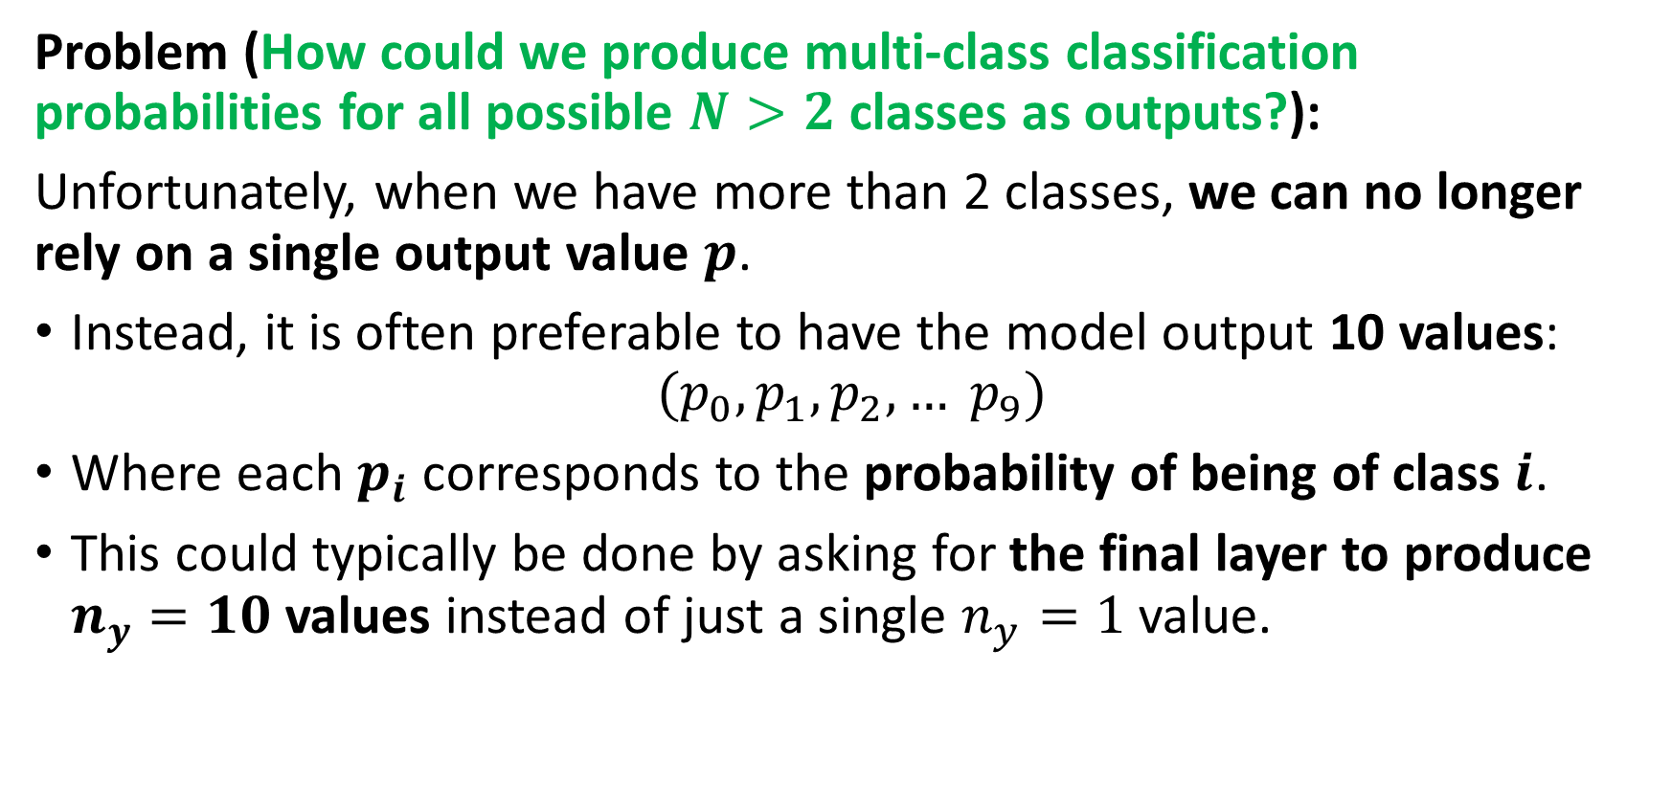
From binary to multi-class classification
Problem (How could we produce multi-class classification probabilities for all possible $N>2$ classes as outputs?):
Unfortunately, when we have more than 2 classes, we can no longer rely on a single output value $p$.
Instead, it is often preferable to have the model output 10 values:
$$(p_{0}, p_{1}, p_{2}, … p_{9})$$
Where each $p_{i}$ corresponds to the probability of being of class $i$.
This could typically be done by asking for the final layer to produce $n_{y}=10$values instead of just a single $n_{y}=1$ value.

Slide 28
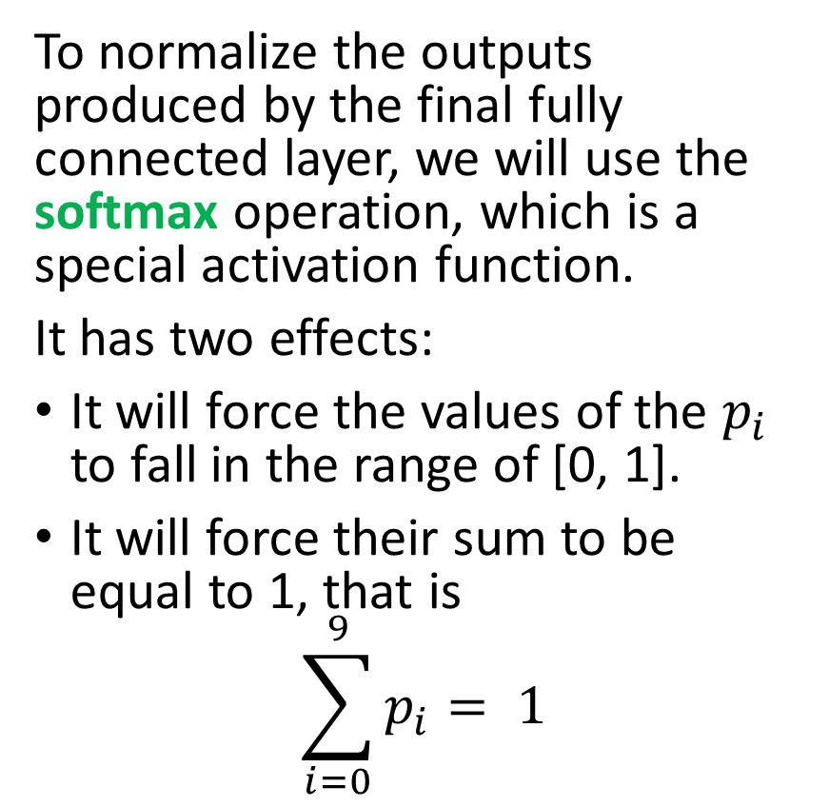
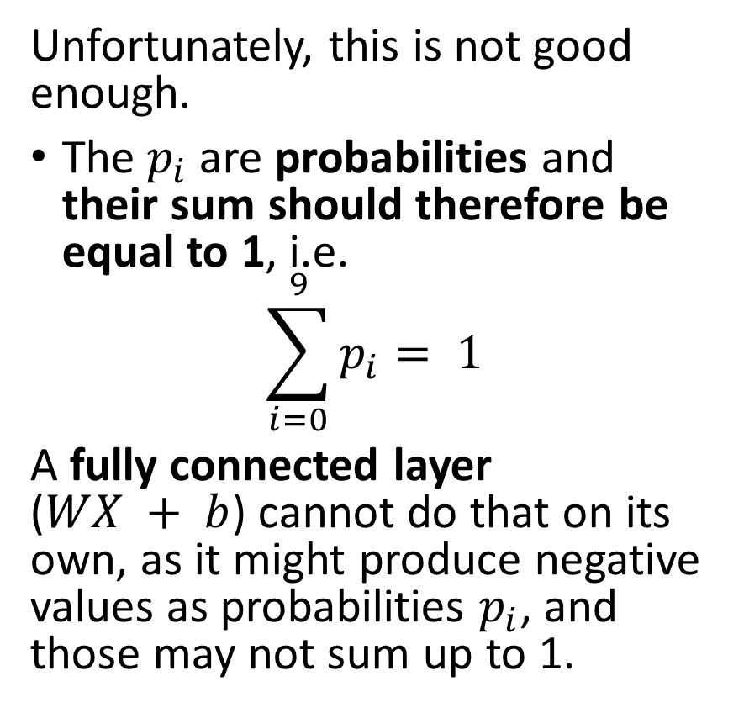
From binary to multi-class classification
Unfortunately, this is not good enough.
The $p_{i}$are probabilities and their sum should therefore be equal to 1, i.e.
$$\sum_{i=0}^{9}{p_{i}}= 1$$
A fully connected layer ($WX + b$) cannot do that on its own, as it might produce negative values as probabilities $p_{i}$, and those may not sum up to 1.
To normalize the outputs produced by the final fully connected layer, we will use the softmax operation, which is a special activation function.
It has two effects:
It will force the values of the $p_{i}$ to fall in the range of [0, 1].
It will force their sum to be equal to 1, that is
$$\sum_{i=0}^{9}{p_{i}}= 1$$

Slide 29
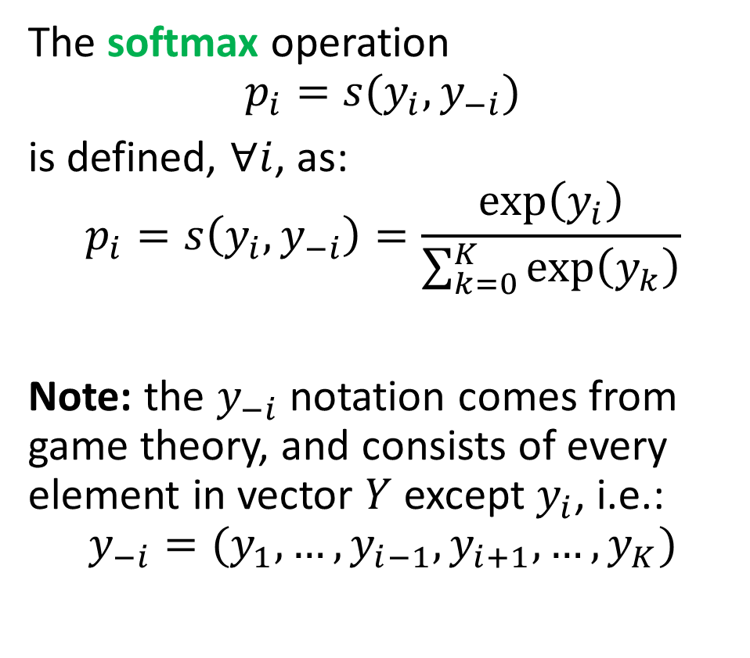
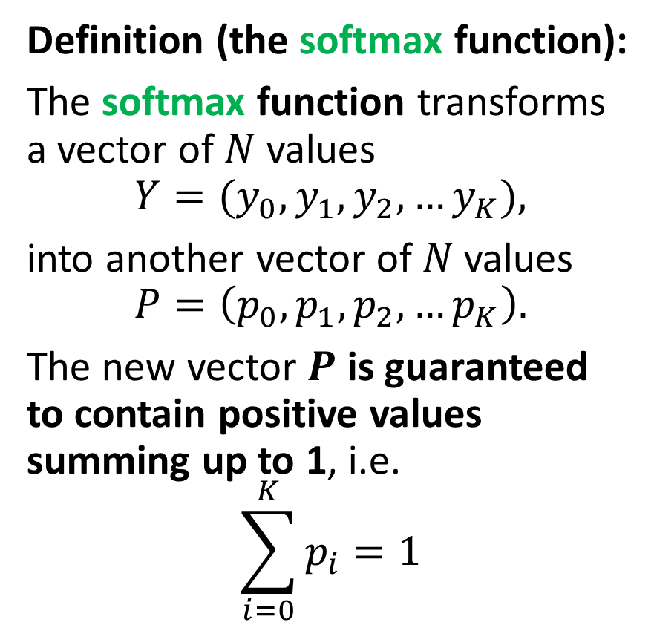
Softmax function
Definition (the softmax function):
The softmax function transforms a vector of $N$ values
$$Y=(y_{0},y_{1},y_{2},…y_{K}),$$
into another vector of 𝑁 values
$$P=\left(p_{0},p_{1},p_{2},…p_{K}\right).$$
The new vector $P$ is guaranteed to contain positive values summing up to 1, i.e.
$$\sum_{i=0}^{K}{p_{i}=1}$$
The softmax operation
$$p_{i}=s(y_{i},y_{−i})$$
is defined, $∀i$, as:
$$p_{i}=s\left(y_{i},y_{−i}\right)=\frac{\exp\left(y_{i}\right)}{\sum_{k=0}^{K}{\exp\left(y_{k}\right)}}$$
Note: the $y_{−i}$ notation comes from game theory, and consists of every element in vector $Y$ except $y_{i}$, i.e.:
$$y_{−i}=(y_{1},…,y_{i−1}, y_{i+1}, …, y_{K})$$

Slide 30
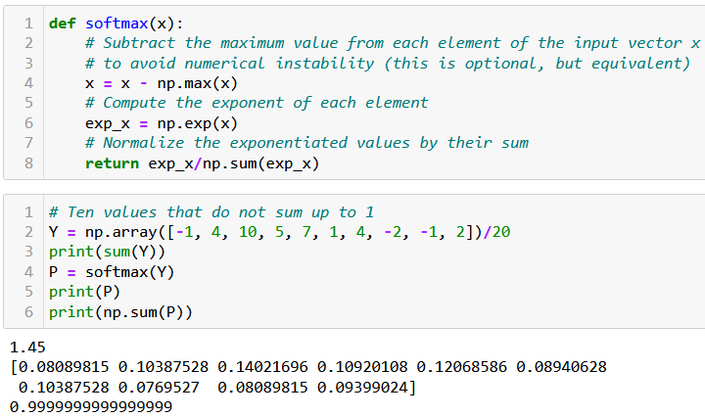
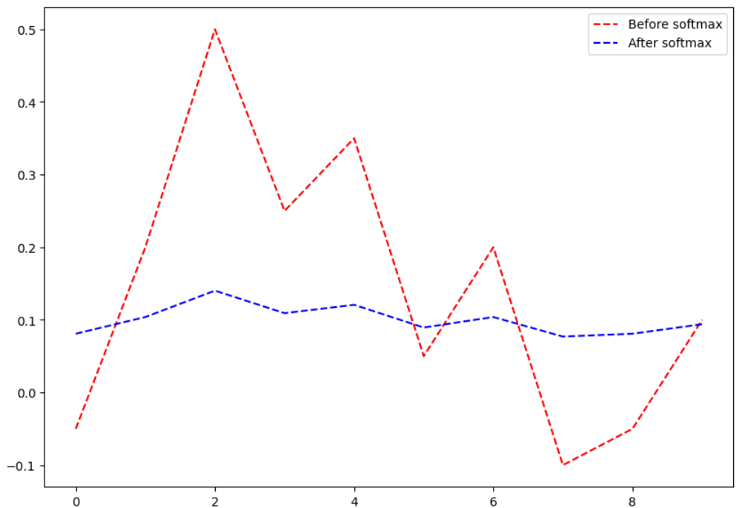
Softmax function
Softmax effect: It will rescale values so that the trend is preserved, but the new vector consists of positive values that sum up to 1.
Softmax can be manually implemented as:

Slide 31
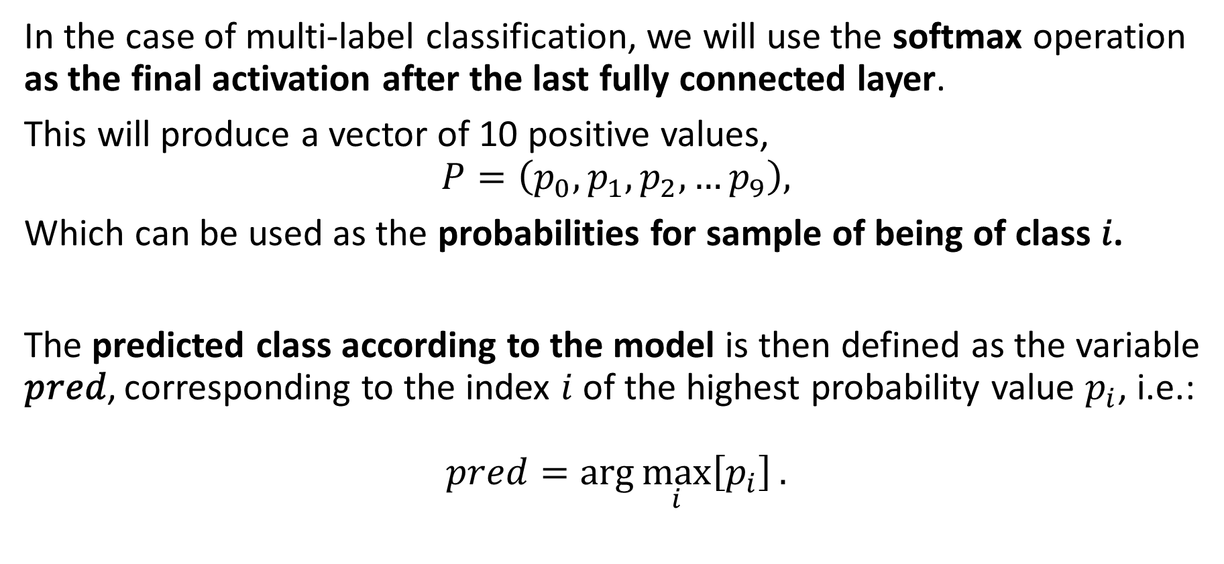
Softmax function and prediction
In the case of multi-label classification, we will use the softmax operation as the final activation after the last fully connected layer.
This will produce a vector of 10 positive values,
$$P=\left(p_{0},p_{1},p_{2},…p_{9}\right),$$
Which can be used as the probabilities for sample of being of class 𝑖.
The predicted class according to the model is then defined as the variable 𝑝𝑟𝑒𝑑, corresponding to the index $i$ of the highest probability value $p_{i}$, i.e.:
$$pred=arg⁡\max_{i}\left[p_{i}\right].$$

Slide 32
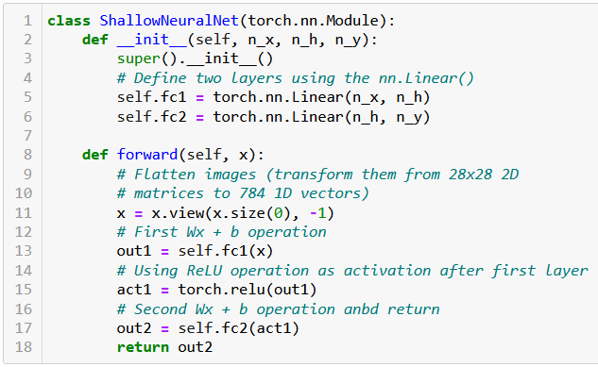
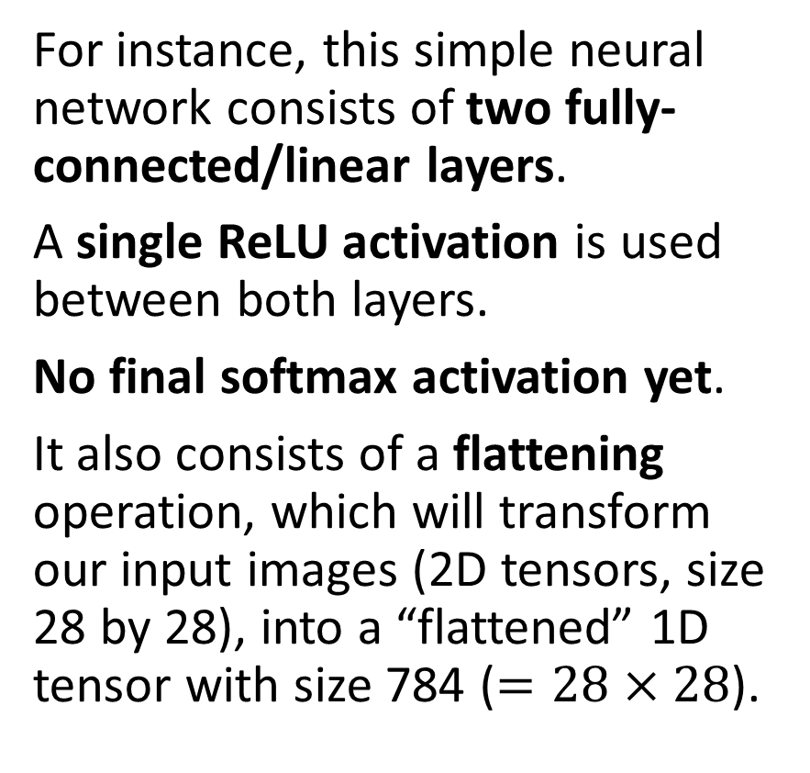
Softmax function and prediction
For instance, this simple neural network consists of two fully-connected/linear layers.
A single ReLU activation is used between both layers.
No final softmax activation yet.
It also consists of a flattening operation, which will transform our input images (2D tensors, size 28 by 28), into a “flattened” 1D tensor with size 784 ($=28×28$).

Slide 33
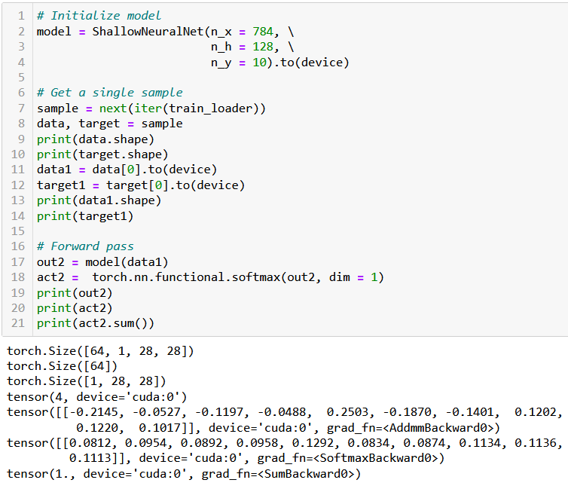
Softmax function
Consider a neural network model, with 784 input size, 128 hidden size, and 10 output size, eventually transferring the model to a device (CPU/CUDA).
Next, we get a single sample from the train_loader iterator and extract sample info in the variables data and target.
This can be simply done with the next and iter functions.

Slide 34
Softmax function
Next, perform a forward pass through the model, storing the output in the variable out2.
Apply the softmax operation on out2. PyTorch offers a functional implmentation of the softmax:
torch.nn.functional.softmax()
We can then verify that softmax will adjust the output of the neural network correctly.

Slide 35
Forward implementation
Our model is however implementing the same forward method as before.
In fact, we will not use the softmax operation as the final activation function in the forward method.
This is normal as the softmax operation will be applied in the loss function instead, that is the cross_entropy() function, which will be summoned in the trainer() later.

Slide 36
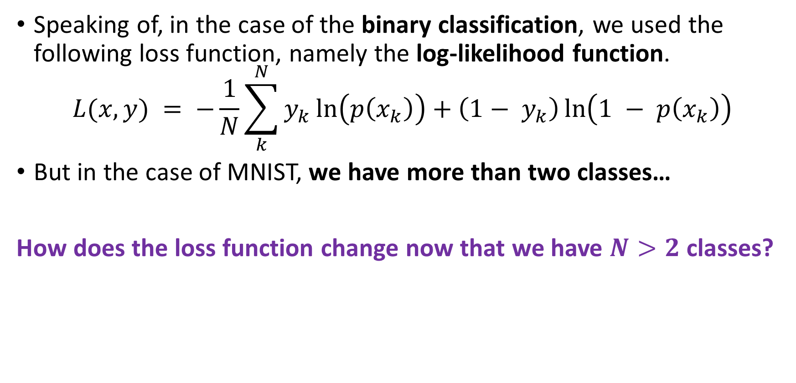
From binary cross entropy…
Speaking of, in the case of the binary classification, we used the following loss function, namely the log-likelihood function.
$$L(x, y) = −\frac{1}{N}\sum_{k}^{N}{y_{k}}\ln\left(p\left(x_{k}\right)\right)+\left(1− y_{k}\right)\ln\left(1 − p\left(x_{k}\right)\right)$$
But in the case of MNIST, we have more than two classes…
How does the loss function change now that we have $N>2$ classes?

Slide 37
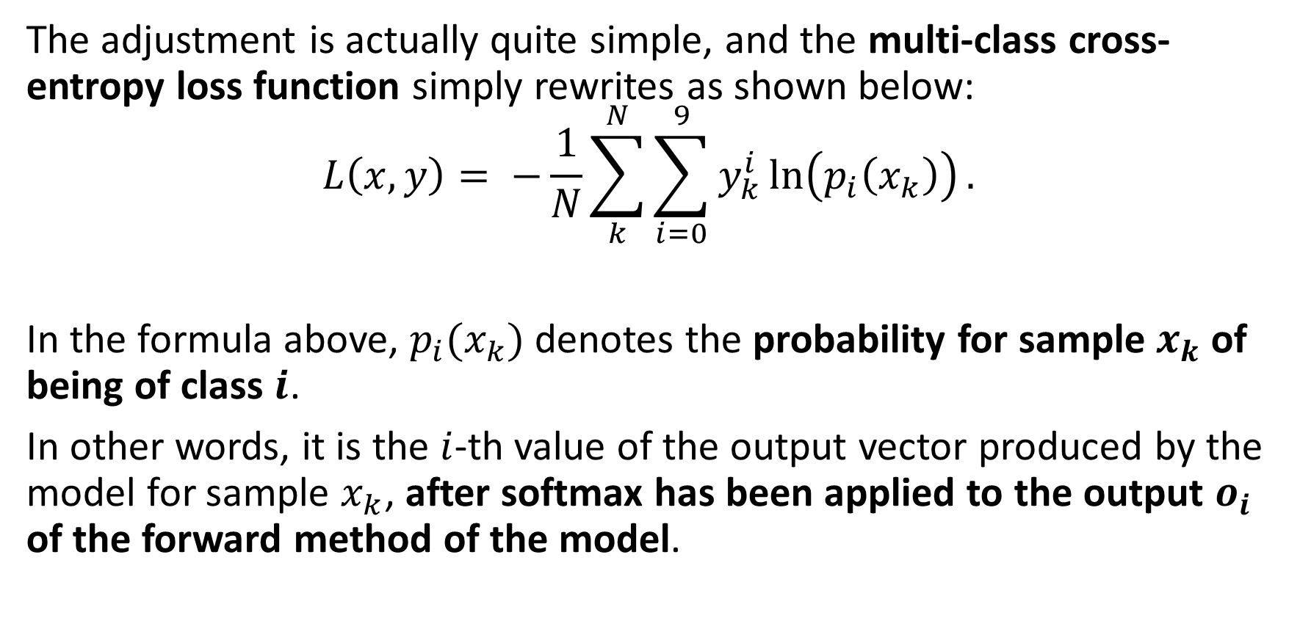
…To multi-class cross entropy!
The adjustment is actually quite simple, and the multi-class cross-entropy loss function simply rewrites as shown below:
$$L\left(x, y\right)= −\frac{1}{N}\sum_{k}^{N}{\sum_{i=0}^{9}{y_{k}^{i}}\ln\left(p_{i}\left(x_{k}\right)\right)}.$$
In the formula above, $p_{i}(x_{k})$denotes the probability for sample $x_{k}$of being of class $i$.
In other words, it is the $i$-th value of the output vector produced by the model for sample $x_{k}$, after softmax has been applied to the output $o_{i}$ of the forward method of the model.

Slide 38
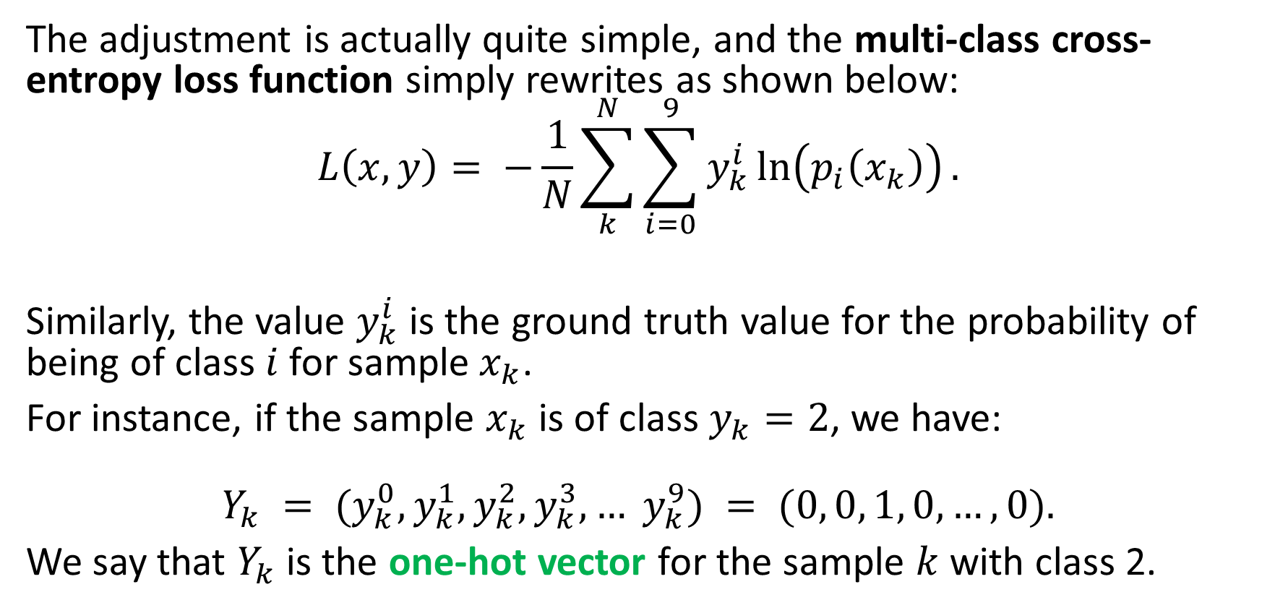
…To multi-class cross entropy!
The adjustment is actually quite simple, and the multi-class cross-entropy loss function simply rewrites as shown below:
$$L\left(x, y\right)= −\frac{1}{N}\sum_{k}^{N}{\sum_{i=0}^{9}{y_{k}^{i}}\ln\left(p_{i}\left(x_{k}\right)\right)}.$$
Similarly, the value $y_{k}^{i}$ is the ground truth value for the probability of being of class $i$ for sample$x_{k}$.
For instance, if the sample $x_{k}$is of class $y_{k}=2$, we have:
$$Y_{k} = (y_{k}^{0}, y_{k}^{1}, y_{k}^{2}, y_{k}^{3}, … y_{k}^{9}) = (0, 0, 1, 0, …, 0).$$
We say that $Y_{k}$ is the one-hot vector for the sample $k$ with class 2.

Slide 39
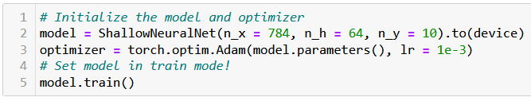
Setting a model in train/eval mode
New good practice: some operations (layers, activations, etc.) in forward will have two different behaviors depending on whether
the model is currently training,
or if we are using its trained version for evaluation.
(Note: at the moment, we have not seen such operations.)
But let us keep this in mind and accept that is good practice to set the model to either train() or eval() mode.

Slide 40
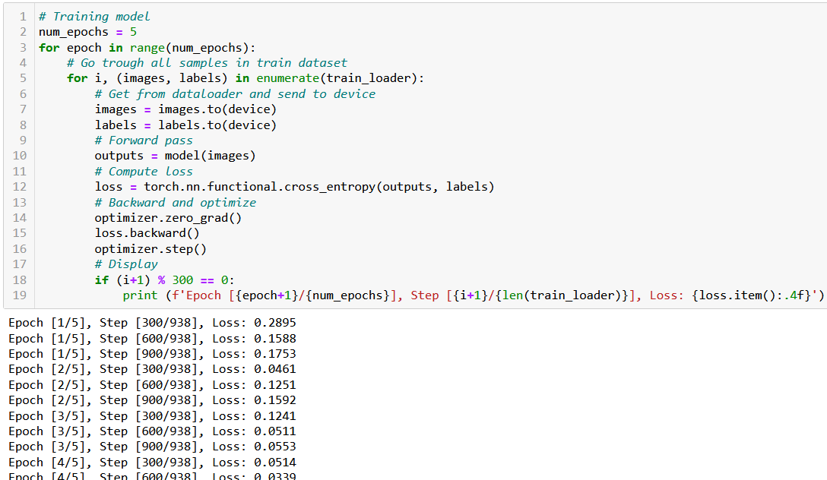
Training our model with Adam GD, as before

Slide 41
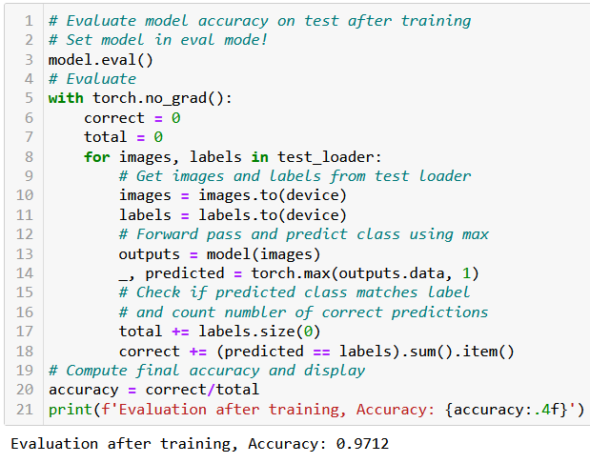
Eval mode and accuracy after training
After training, we will evaluate our trained model to check its accuracy on test set.
Set the model in eval() mode (good practice for later).
Predict on test dataloader.
Calculate accuracy manually (we could have probably also used a torch function to do that).
97% accuracy = a rather nicely trained model!

Slide 42
It is now time…
It is now time for us to define and train our first Deep Neural Network.
Definition (Deep Neural Networks):
By definition, a deep neural network is a neural network, which consists of more than two layers.
To demonstrate, we will create a deep neural network with four layers:
three linear layers with ReLU activation,
followed by one linear layer, finished with a softmax activation.

Slide 43
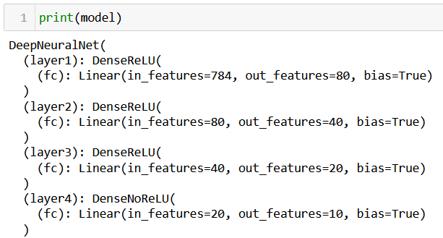
It is now time…
In general, it is good practice to have the size of layers decrease progressively by a factor of at least 2.
the first layer has inputs size 784 and outputs size 80,
the second layer has inputs size 80 and outputs size 40,
the third layer has inputs size 40 and outputs size 20,
and the fourth layer has inputs size 20 and outputs size 10, matching the number of classes in the dataset.
Note: a layer-by-layer model summary can be seen by printing the model object!

Slide 44
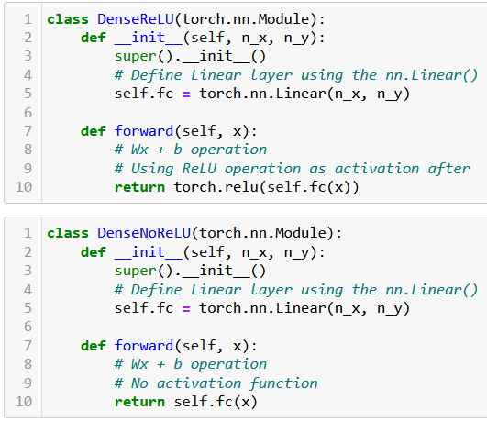
Creating blocks
Good practice (another one): create building blocks for modularity.
The DenseReLU class is a custom PyTorch module that consists of a linear layer followed by a ReLU activation function.
The DenseNoRELU class is similar, but it applies no activation function.
Important note: not using softmax as final activation, for the same reasons as before.

Slide 45
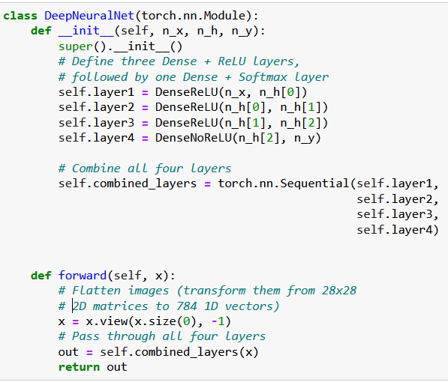

Creating blocks
The DeepNeuralNet class will here represent the overall deep neural network.
It starts by initializing four layers:
Three DenseReLU blocks,
And one DenseNoReLU block.
It then combines them into a single PyTorch sequential model using torch.nn.Sequential().

Slide 46
Creating blocks
The forward pass of the network is then simply defined, using the following steps:
The input image is flattened, transforming a 2D tensor image into a 1D tensor,
It is then passed through the combined layers/blocks we have assembled in Sequential().

Slide 47
Creating blocks
Good practice: This modular approach,
Defining blocks of layers,
And eventually assembling them in a larger Deep Neural Network network,
is very common in deep neural networks, especially when the architectures are very heavy and include many layers.
Helps to organize the mess!

Slide 48
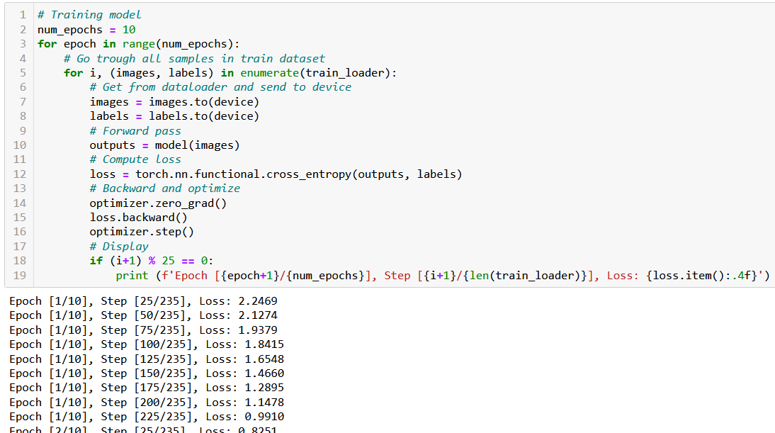
Training our model as before

Slide 49
On Deep Neural Networks complexity
We can therefore raise a fairly important question:
What is the appropriate number of layers to use and how many neurons should we use on each layer?
We established in Week 2 – Notebook 8, that there is no fixed rule for how many layers should be used in a deep neural network.
Instead, the number of layers, as well as the number of neurons in each layer, should be chosen based on the complexity of the task and the amount of available data in the dataset.
In general, deep neural networks with many layers (tens or even hundreds) can learn very complex patterns in data, but they will require a large amount of data and computational resources to train.

Slide 50
On Deep Neural Networks complexity
More importantly, if the network is too deep, it may also be prone to overfitting, which can hinder its generalization performance on unseen data.
On the other hand, shallow networks with fewer layers may be easier to train and require less data, but they may not be able to learn as complex patterns.
Another No Free Lunch: Finding the optimal number of layers and the optimal architecture of a deep neural network is often a trade-off between model complexity, computational resources, and performance. It requires some experimentation and model selection.

Slide 51
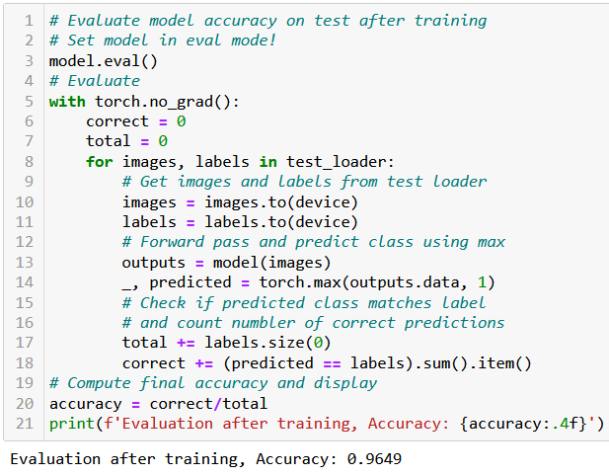
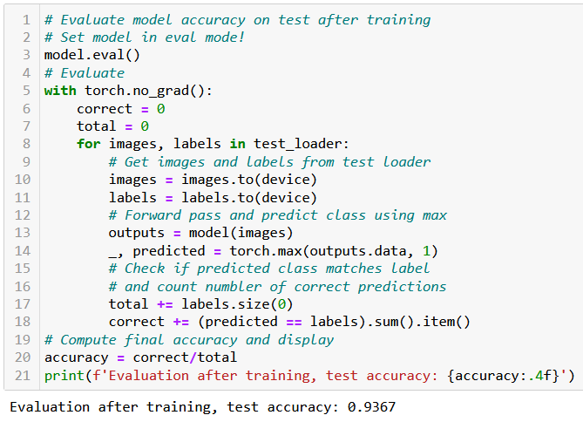
In fact, our DNN is overfitting at the moment!
Shallow Neural Net: 96.5% test acc (not too bad)
Deep Neural Net: 93.7% test acc (lower, even though we had a lower loss!)

Slide 52
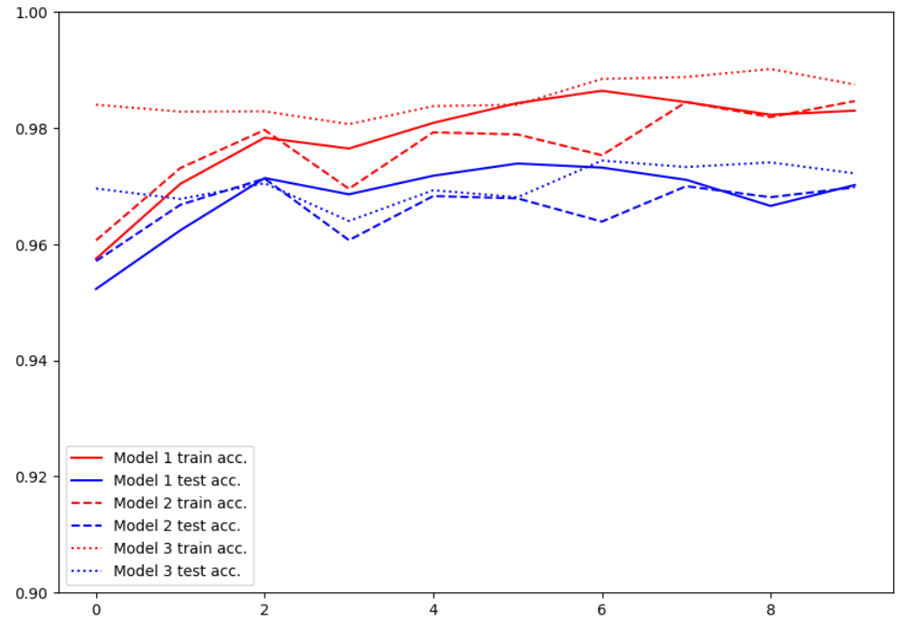
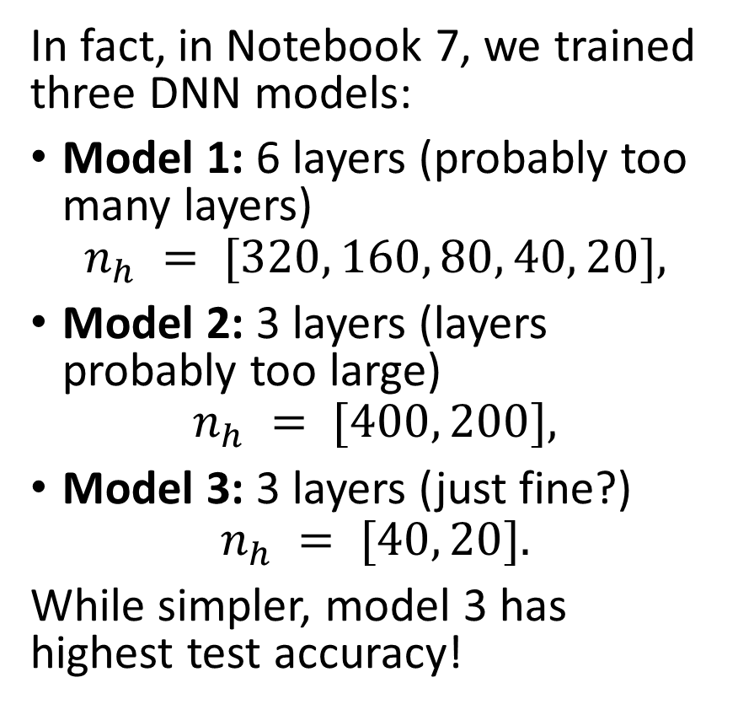
Experimenting on layers numbers and sizes
In fact, in Notebook 7, we trained three DNN models:
Model 1: 6 layers (probably too many layers)
$$n_{h} = [320, 160, 80, 40, 20],$$
Model 2: 3 layers (layers probably too large)
$$n_{h} = [400, 200],$$
Model 3: 3 layers (just fine?)
$$n_{h} = [40, 20].$$
While simpler, model 3 has highest test accuracy!
Important lesson: Larger and deeper network does not necessarily mean better performance!

Slide 53
Introduction (Week 3)
What is the PyTorch library and its benefits?
What is a PyTorch tensor object and its typical attributes?
How to implement some typical tensor operations?
What is broadcasting on tensors?
What are tensor locations in terms of computation?
How to transform our original NumPy shallow Neural Network class so it uses PyTorch now instead?
How to implement a forward, loss and accuracy metric in PyTorch?
What are some measurable performance benefits of using PyTorch over NumPy and GPUs over CPUs?

Slide 54
Introduction (Week 3)
What is the autograd/backprop module in PyTorch, and how does it use a computational graph to compute all derivatives?
How to use the autograd to implement derivatives and a vanilla gradient descent?
How to implement backprop in PyTorch for our shallow Neural Network class?
How to use PyTorch to implement advanced optimizers?
How to use PyTorch to implement advanced initializers?
How to use PyTorch to implement regularization?
How to finally revise our trainer function to obtain a minimal, yet complete Neural Network in PyTorch?

Slide 55
Introduction (Week 3)
What are the Dataset and Dataloader objects in PyTorch?
How to implement a custom Dataloader and Dataset object in PyTorch?
How to move from binary classification to multi-class classification?
How to adjust output probabilities using the softmax function?
How to change the cross-entropy loss so it works in multi-class classification?
How to implement building blocks in PyTorch?
How to implement and train our first Deep Neural Network?
What are additional good practices in PyTorch?

Slide 56
Conclusion (Week 3)
PyTorch library and its benefits
Tensor objects, attributes and operations on tensors
Converting our NumPy shallow neural network into PyTorch
Parameter objects
Forward method implementation
Performance benefits of GPU acceleration
Using autograd and compuitational graphs
Advanced optimizers in PyTorch
Initializers in PyTorch
Regularization in PyTorch
Dataset and Dataloader objects
Multi-class classification
Softmax function and multi-class cross entropy loss
Building blocks in PyTorch
Our first Deep Neural Network!
Network size vs. overfitting tradeoff

Slide 57
Project announcement!
Let us discuss it now.

